Slide 1
Digital Design & Computer Arch. Lecture 23a: Multiprocessor Caches
Prof. Onur Mutlu
ETH Zürich
Spring 2020
22 May 2020

Slide 2
Readings
Caches
Required
H&H Chapters 8.1-8.3
Refresh: P&P Chapter 3.5
Recommended
An early cache paper by Maurice Wilkes
Wilkes, “Slave Memories and Dynamic Storage Allocation,” IEEE Trans. On Electronic Computers, 1965.

Slide 3
Recall: Cache Structure
Address
Tag Store
(is the address
in the cache?
+ bookkeeping)
Data Store
(stores
memory
blocks)
Hit/miss?
Data

Slide 4
Cache Performance

Slide 5
Recall: Cache Parameters vs. Miss/Hit Rate
Cache size
Block size
Associativity
Replacement policy
Insertion/Placement policy

Slide 6
Recall: How to Improve Cache Performance
Three fundamental goals
Reducing miss rate
Caveat: reducing miss rate can reduce performance if more costly-to-refetch blocks are evicted
Reducing miss latency or miss cost
Reducing hit latency or hit cost
The above three together affect performance

Slide 7
Recall: Improving Basic Cache Performance
Reducing miss rate
More associativity
Alternatives/enhancements to associativity
Victim caches, hashing, pseudo-associativity, skewed associativity
Better replacement/insertion policies
Software approaches
Reducing miss latency/cost
Multi-level caches
Critical word first
Subblocking/sectoring
Better replacement/insertion policies
Non-blocking caches (multiple cache misses in parallel)
Multiple accesses per cycle
Software approaches

Slide 8
Recall: Software Approaches for Higher Hit Rate
Restructuring data access patterns
Restructuring data layout
Loop interchange
Data structure separation/merging
Blocking
…

Slide 9
Recall: Restructuring Data Access Patterns (I)
Idea: Restructure data layout or data access patterns
Example: If column-major
x[i+1,j] follows x[i,j] in memory
x[i,j+1] is far away from x[i,j]
This is called loop interchange
Other optimizations can also increase hit rate
Loop fusion, array merging, …
Poor code
for i = 1, rows
for j = 1, columns
sum = sum + x[i,j]
Better code
for j = 1, columns
for i = 1, rows
sum = sum + x[i,j]

Slide 10
Recall: Restructuring Data Access Patterns (II)
Blocking
Divide loops operating on arrays into computation chunks so that each chunk can hold its data in the cache
Avoids cache conflicts between different chunks of computation
Essentially: Divide the working set so that each piece fits in the cache
Also called Tiling

Slide 11
Restructuring Data Layout (I)
Pointer based traversal (e.g., of a linked list)
Assume a huge linked list (1B nodes) and unique keys
Why does the code on the left have poor cache hit rate?
“Other fields” occupy most of the cache line even though rarely accessed!
struct Node {
struct Node* next;
int key;
char [256] name;
char [256] school;
}
while (node) {
if (node→key == input-key) {
// access other fields of node
}
node = node→next;
}

Slide 12
Restructuring Data Layout (II)
struct Node {
struct Node* next;
int key;
struct Node-data* node-data;
}
struct Node-data {
char [256] name;
char [256] school;
}
while (node) {
if (node→key == input-key) {
// access node→node-data
}
node = node→next;
}
Idea: separate frequently-used fields of a data structure and pack them into a separate data structure
Who should do this?
Programmer
Compiler
Profiling vs. dynamic
Hardware?
Who can determine what is frequently used?

Slide 13
Multi-Core Issues in Caching

Slide 14
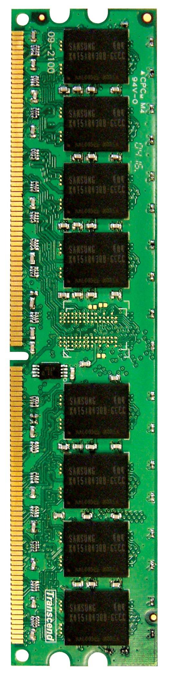
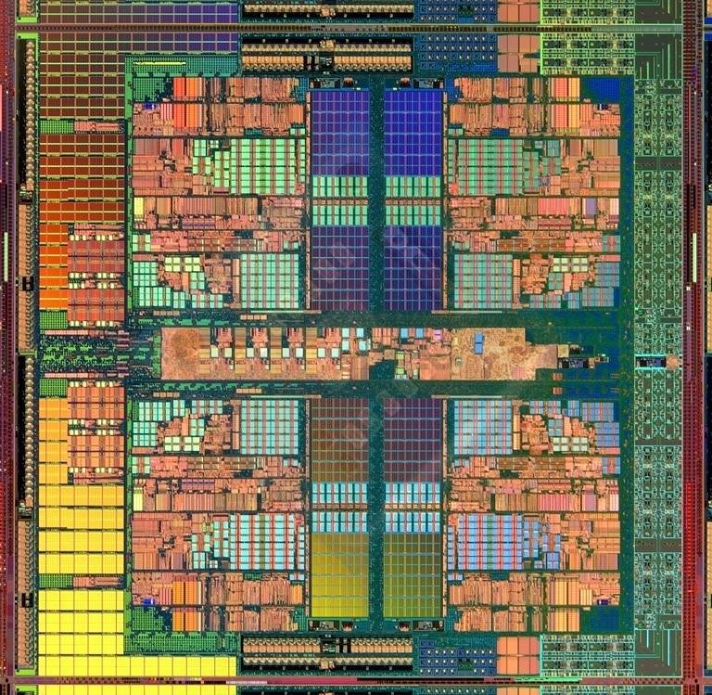
Caches in a Multi-Core System
CORE 0
L2 CACHE 1
CORE 1
L2 CACHE 0
SHARED L3 CACHE
DRAM INTERFACE
DRAM MEMORY CONTROLLER
DRAM BANKS
L2 CACHE 2
CORE 3
CORE 2
L2 CACHE 3

Slide 15
Caches in Multi-Core Systems
Cache efficiency becomes even more important in a multi-core/multi-threaded system
Memory bandwidth is at premium
Cache space is a limited resource across cores/threads
How do we design the caches in a multi-core system?
Many decisions
Shared vs. private caches
How to maximize performance of the entire system?
How to provide QoS to different threads in a shared cache?
Should cache management algorithms be aware of threads?
How should space be allocated to threads in a shared cache?

Slide 16
Private vs. Shared Caches
Private cache: Cache belongs to one core (a shared block can be in multiple caches)
Shared cache: Cache is shared by multiple cores
CORE 0
CORE 1
CORE 2
CORE 3
CORE 0
CORE 1
CORE 2
CORE 3
L2
CACHE
L2
CACHE
L2
CACHE
L2
CACHE
L2
CACHE
DRAM MEMORY CONTROLLER
DRAM MEMORY CONTROLLER

Slide 17
Resource Sharing Concept and Advantages
Idea: Instead of dedicating a hardware resource to a hardware context, allow multiple contexts to use it
Example resources: functional units, pipeline, caches, buses, memory
Why?
+ Resource sharing improves utilization/efficiency → throughput
When a resource is left idle by one thread, another thread can use it; no need to replicate shared data
+ Reduces communication latency
For example, data shared between multiple threads can be kept in the same cache in multithreaded processors
+ Compatible with the shared memory programming model

Slide 18
Resource Sharing Disadvantages
Resource sharing results in contention for resources
When the resource is not idle, another thread cannot use it
If space is occupied by one thread, another thread needs to re-occupy it
- Sometimes reduces each or some thread’s performance
- Thread performance can be worse than when it is run alone
- Eliminates performance isolation → inconsistent performance across runs
- Thread performance depends on co-executing threads
- Uncontrolled (free-for-all) sharing degrades QoS
- Causes unfairness, starvation
Need to efficiently and fairly utilize shared resources

Slide 19
Private vs. Shared Caches
Private cache: Cache belongs to one core (a shared block can be in multiple caches)
Shared cache: Cache is shared by multiple cores
CORE 0
CORE 1
CORE 2
CORE 3
CORE 0
CORE 1
CORE 2
CORE 3
L2
CACHE
L2
CACHE
L2
CACHE
L2
CACHE
L2
CACHE
DRAM MEMORY CONTROLLER
DRAM MEMORY CONTROLLER

Slide 20
Shared Caches Between Cores
Advantages:
High effective capacity
Dynamic partitioning of available cache space
No fragmentation due to static partitioning
If one core does not utilize some space, another core can
Easier to maintain coherence (a cache block is in a single location)
Disadvantages
Slower access (cache not tightly coupled with the core)
Cores incur conflict misses due to other cores’ accesses
Misses due to inter-core interference
Some cores can destroy the hit rates of other cores
Guaranteeing a minimum level of service (or fairness) to each core is harder (how much space, how much bandwidth?)

Slide 21
Example: Problem with Shared Caches
Processor Core 1
←t1
Processor Core 2
L1 $
L1 $
L2 $
……
Kim et al., “Fair Cache Sharing and Partitioning in a Chip Multiprocessor Architecture,” PACT 2004.

Slide 22
Example: Problem with Shared Caches
Processor Core 1
t2→
Processor Core 2
L1 $
L1 $
L2 $
……
Kim et al., “Fair Cache Sharing and Partitioning in a Chip Multiprocessor Architecture,” PACT 2004.

Slide 23
Example: Problem with Shared Caches
Processor Core 1
←t1
t2→
Processor Core 2
L1 $
L1 $
L2 $
……
t2’s throughput can be significantly reduced due to unfair cache sharing.
Kim et al., “Fair Cache Sharing and Partitioning in a Chip Multiprocessor Architecture,” PACT 2004.

Slide 24
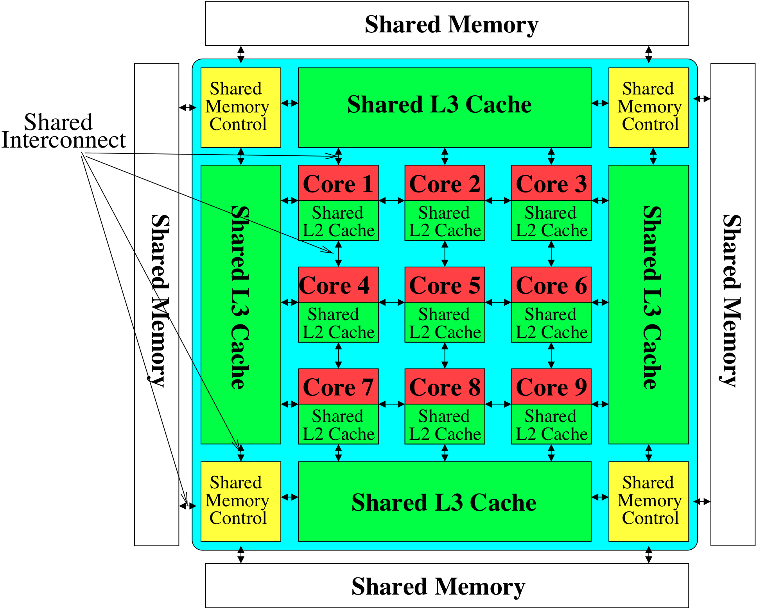
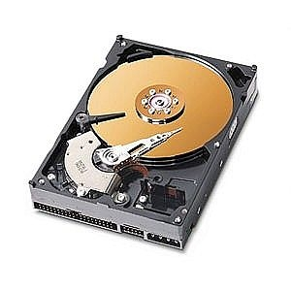
Memory System: A Shared Resource View
Storage
Most of the system is a shared resource, storing and moving data

Slide 25
Cache Coherence

Slide 26
Cache Coherence
Basic question: If multiple processors cache the same block, how do they ensure they all see a consistent state?
P1
P2
Interconnection Network
1000
x
Main Memory

Slide 27
The Cache Coherence Problem
P1
P2
ld r2, x
1000
Interconnection Network
1000
x
Main Memory

Slide 28
The Cache Coherence Problem
P1
P2
ld r2, x
ld r2, x
1000
1000
Interconnection Network
x
1000
Main Memory

Slide 29
The Cache Coherence Problem
P1
P2
ld r2, x
ld r2, x
add r1, r2, r4
st x, r1
2000
1000
Interconnection Network
1000
x
Main Memory

Slide 30
The Cache Coherence Problem
P1
P2
ld r2, x
ld r2, x
add r1, r2, r4
st x, r1
2000
1000
Should NOT load 1000
ld r5, x
Interconnection Network
1000
x
Main Memory

Slide 31
Cache Coherence: Whose Responsibility?
Software
Can the programmer ensure coherence if caches are invisible to software?
What if the ISA provided a cache flush instruction?
FLUSH-LOCAL A: Flushes/invalidates the cache block containing address A from a processor’s local cache.
FLUSH-GLOBAL A: Flushes/invalidates the cache block containing address A from all other processors’ caches.
FLUSH-CACHE X: Flushes/invalidates all blocks in cache X.
Hardware
Simplifies software’s job
One idea: Invalidate all other copies of block A when a processor writes to it

Slide 32
A Very Simple Coherence Scheme (VI)
Caches “snoop” (observe) each other’s write/read operations via a shared bus. If a processor writes to a block, all others invalidate the block.
A simple protocol:
PrRd/--
PrWr / BusWr
Write-through, no-write-allocate cache
Actions of the local processor on the cache block: PrRd, PrWr,
Actions that are broadcast on the bus for the block: BusRd, BusWr
Valid
BusWr
PrRd / BusRd
Invalid
PrWr / BusWr

Slide 33
(Non-)Solutions to Cache Coherence
No hardware based coherence
Keeping caches coherent is software’s responsibility
+ Makes microarchitect’s life easier
-- Makes average programmer’s life much harder
need to worry about hardware caches to maintain program correctness?
-- Overhead in ensuring coherence in software (e.g., page protection and page-based software coherence)
All caches are shared between all processors
+ No need for coherence
-- Shared cache becomes the bandwidth bottleneck
-- Very hard to design a scalable system with low-latency cache access this way

Slide 34
Maintaining Coherence
Need to guarantee that all processors see a consistent value (i.e., consistent updates) for the same memory location
Writes to location A by P0 should be seen by P1 (eventually), and all writes to A should appear in some order
Coherence needs to provide:
Write propagation: guarantee that updates will propagate
Write serialization: provide a consistent order seen by all processors for the same memory location
Need a global point of serialization for this store ordering

Slide 35
Hardware Cache Coherence
Basic idea:
A processor/cache broadcasts its write/update to a memory location to all other processors
Another cache that has the location either updates or invalidates its local copy
Two major approaches
Snoopy bus (all operations are broadcast on a shared bus)
Directory based (a mediator gives permission to each request)
To learn more, take the Graduate Comp Arch class
https://safari.ethz.ch/architecture/fall2019/doku.php?id=schedule

Slide 36
Digital Design & Computer Arch. Lecture 23a: Multiprocessor Caches
Prof. Onur Mutlu
ETH Zürich
Spring 2020
22 May 2020

Slide 37
Cache Examples: For You to Study

Slide 38
Cache Terminology
Capacity (C):
the number of data bytes a cache stores
Block size (b):
bytes of data brought into cache at once
Number of blocks (B = C/b):
number of blocks in cache: B = C/b
Degree of associativity (N):
number of blocks in a set
Number of sets (S = B/N):
each memory address maps to exactly one cache set

Slide 39
How is data found?
Cache organized into S sets
Each memory address maps to exactly one set
Caches categorized by number of blocks in a set:
Direct mapped: 1 block per set
N-way set associative: N blocks per set
Fully associative: all cache blocks are in a single set
Examine each organization for a cache with:
Capacity (C = 8 words)
Block size (b = 1 word)
So, number of blocks (B = 8)

Slide 40
Direct Mapped Cache

Slide 41
Direct Mapped Cache Hardware

Slide 42
Direct Mapped Cache Performance
# MIPS assembly code
addi $t0, $0, 5
loop: beq $t0, $0, done
lw $t1, 0x4($0)
lw $t2, 0xC($0)
lw $t3, 0x8($0)
addi $t0, $t0, -1
j loop
done:
Miss Rate =
42

Slide 43
Direct Mapped Cache Performance
# MIPS assembly code
addi $t0, $0, 5
loop: beq $t0, $0, done
lw $t1, 0x4($0)
lw $t2, 0xC($0)
lw $t3, 0x8($0)
addi $t0, $t0, -1
j loop
done:
Miss Rate = 3/15 = 20%
Temporal Locality Compulsory Misses
43

Slide 44
Direct Mapped Cache: Conflict
# MIPS assembly code
addi $t0, $0, 5
loop: beq $t0, $0, done
lw $t1, 0x4($0)
lw $t2, 0x24($0)
addi $t0, $t0, -1
j loop
done:
Miss Rate =
44

Slide 45
Direct Mapped Cache: Conflict
# MIPS assembly code
addi $t0, $0, 5
loop: beq $t0, $0, done
lw $t1, 0x4($0)
lw $t2, 0x24($0)
addi $t0, $t0, -1
j loop
done:
Miss Rate = 10/10 = 100%
Conflict Misses
45

Slide 46
N-Way Set Associative Cache

Slide 47
N-way Set Associative Performance
# MIPS assembly code
addi $t0, $0, 5
loop: beq $t0, $0, done
lw $t1, 0x4($0)
lw $t2, 0x24($0)
addi $t0, $t0, -1
j loop
done:
Miss Rate =
47

Slide 48
N-way Set Associative Performance
# MIPS assembly code
addi $t0, $0, 5
loop: beq $t0, $0, done
lw $t1, 0x4($0)
lw $t2, 0x24($0)
addi $t0, $t0, -1
j loop
done:
Miss Rate = 2/10
= 20%
Associativity reduces conflict misses
48

Slide 49
Fully Associative Cache
No conflict misses
Expensive to build
49

Slide 50
Spatial Locality?
Increase block size:
Block size, b = 4 words
C = 8 words
Direct mapped (1 block per set)
Number of blocks, B = C/b = 8/4 = 2
50

Slide 51
Direct Mapped Cache Performance
addi $t0, $0, 5
loop: beq $t0, $0, done
lw $t1, 0x4($0)
lw $t2, 0xC($0)
lw $t3, 0x8($0)
addi $t0, $t0, -1
j loop
done:
Miss Rate =
51

Slide 52
Direct Mapped Cache Performance
addi $t0, $0, 5
loop: beq $t0, $0, done
lw $t1, 0x4($0)
lw $t2, 0xC($0)
lw $t3, 0x8($0)
addi $t0, $t0, -1
j loop
done:
Miss Rate = 1/15
= 6.67%
Larger blocks reduce compulsory misses through spatial locality
52

Slide 53
Cache Organization Recap
Main Parameters
Capacity: C
Block size: b
Number of blocks in cache: B = C/b
Number of blocks in a set: N
Number of Sets: S = B/N
Organization | Number of Ways (N) | Number of Sets (S = B/N)
Direct Mapped | 1 | B
N-Way Set Associative | 1 < N < B | B / N
Fully Associative | B | 1
53

Slide 54
Capacity Misses
Cache is too small to hold all data of interest at one time
If the cache is full and program tries to access data X that is not in cache, cache must evict data Y to make room for X
Capacity miss occurs if program then tries to access Y again
X will be placed in a particular set based on its address
In a direct mapped cache, there is only one place to put X
In an associative cache, there are multiple ways where X could go in the set.
How to choose Y to minimize chance of needing it again?
Least recently used (LRU) replacement: the least recently used block in a set is evicted when the cache is full.

Slide 55
Types of Misses
Compulsory: first time data is accessed
Capacity: cache too small to hold all data of interest
Conflict: data of interest maps to same location in cache
Miss penalty: time it takes to retrieve a block from lower level of hierarchy

Slide 56
LRU Replacement
# MIPS assembly
lw $t0, 0x04($0)
lw $t1, 0x24($0)
lw $t2, 0x54($0)
56

Slide 57
LRU Replacement
# MIPS assembly
lw $t0, 0x04($0)
lw $t1, 0x24($0)
lw $t2, 0x54($0)
57

